Slide 1
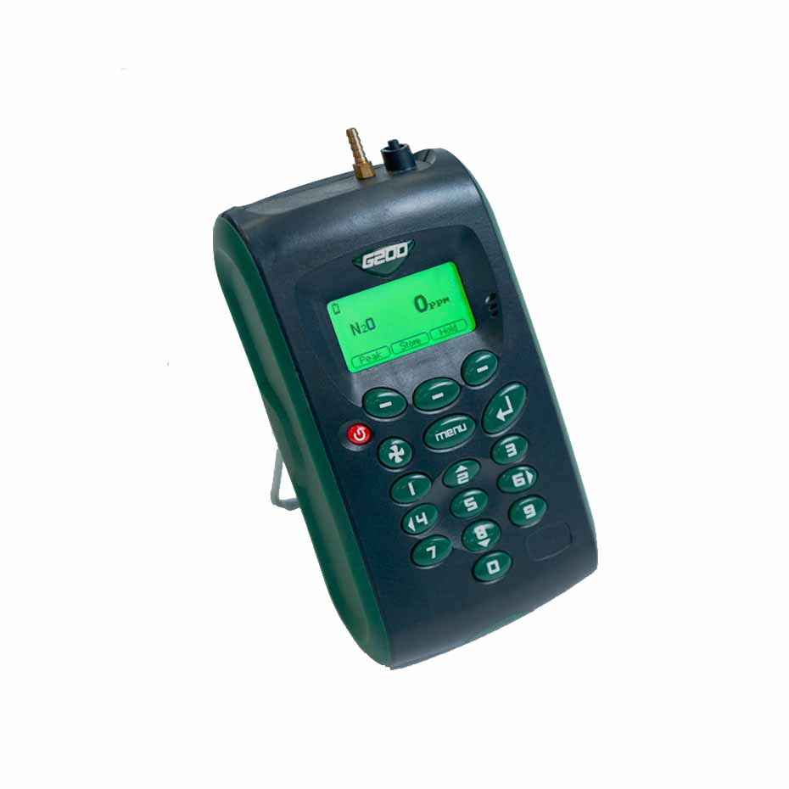
G200 FAQ’s

Slide 2
G200 FAQ’s
Question | Answer
What is the life span of the soda lime filter? | The life of the filter will vary depending on usage. The crystals change colour from pale green-blue to white-grey. The filter element should be discarded when a significant percentage of the crystals start to turn the white-grey colour.
Why does my unit show small lines and dots on the display? | This is something that is common with this platform and is just the nature of the display. When firmware bytes are automatically reset this rectifies the display. However, should this issue be recurring the instrument may need to be investigated.
What accuracy should the check gas be when user calibrating the G200 models? | This is completely up to the user and is dependent upon their specific requirements and how accurate a user calibration they are looking for. The check gases we supply are of a +/-2% accuracy.

Slide 3
G200 FAQ’s
Question | Answer
What is the benefit of purchasing Analyser Data Management software? | What is the benefit of purchasing Analyser Data Management software? The analyser data management software enables the user to: – Obtain instrument status – View the instrument’s readings and event log data – Download and store readings for further analysis – Download graphs of instrument readings – View, import and export the instrument configuration – Update the instrument’s firmware – Copy data from the application into other packages, such as Microsoft Excel – Email data directly from the application – Configure remote access to a central database\print graph and tabular data Take a look at our video explaining how to use ADM.

Slide 4
G200 FAQ’s
Question | Answer
Can you change the units of measurement on the temperature probe? | The units of measurement can be changed via the menu, utilities and setting screen.
How often should a user calibration be performed? | This is dependent upon frequency of usage. In general, the instrument should not require a user calibration more than once a month, but we do recommend verifying the instrument’s operation each day or with each monitoring session with check gas.

